Slide 1
Atlas-based Segmentation Consists of a Powerful Baseline for Brain Tissue Segmentation when Compared to a ML-based Approach
Group 1: Antoine Biebuyck, Nathan Hoffman, Sandro Scherrer

Slide 2
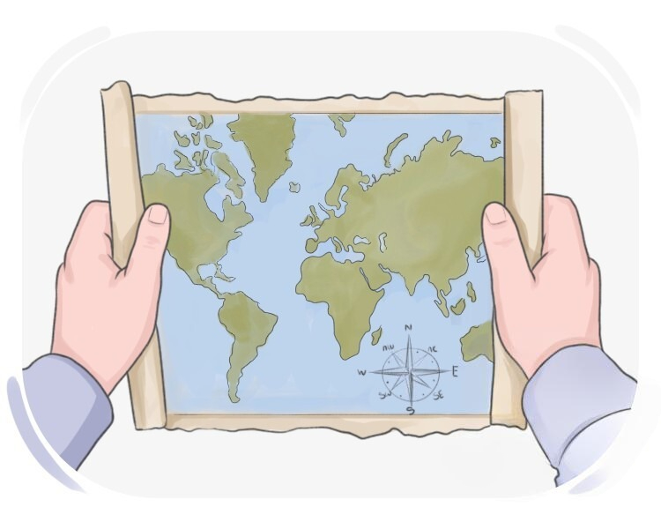
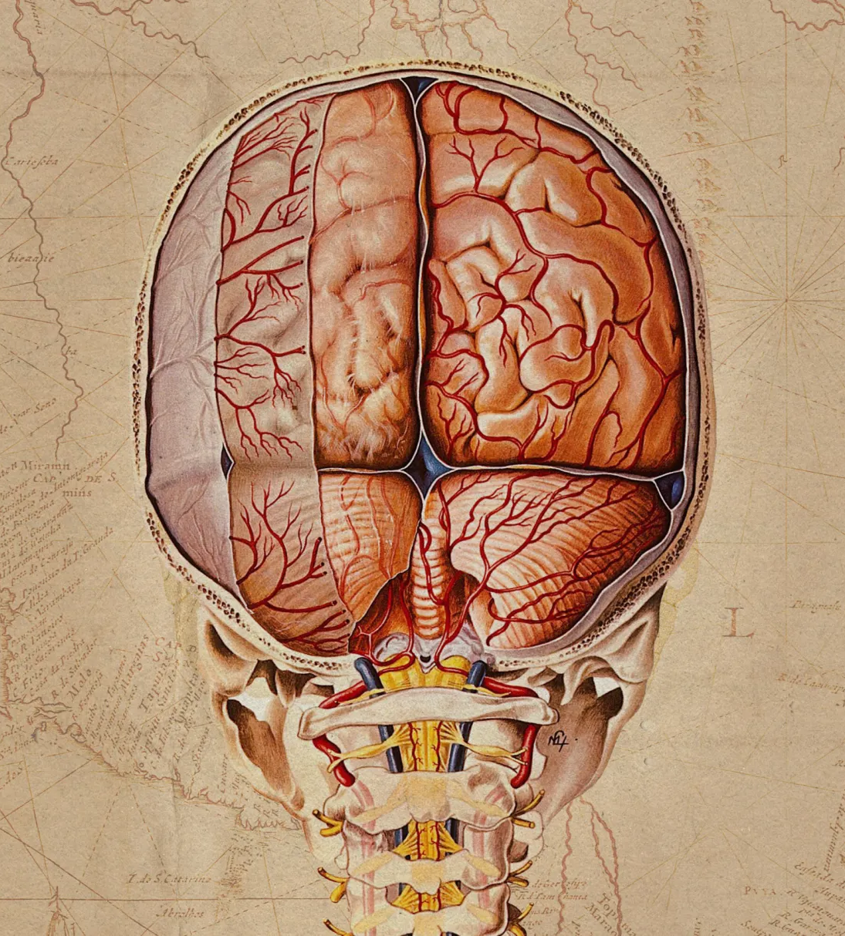
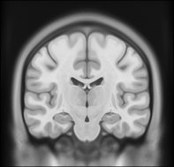
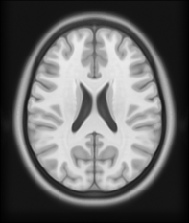
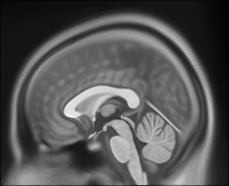
What is an Atlas?
Anatomical representation of the brain showing population-wise brain features. [1]
Derived by statistically summarizing voxel-wise, regional or global brain MRI measures from several individuals. [1]
Reliability and relevance to the clinical population on which they are being used is paramount. [1]
[2]
Notes:
An important consideration when generating an atlas is that the reliability and relevance to the clinical population on which the atlas is being used, is given.

Slide 3
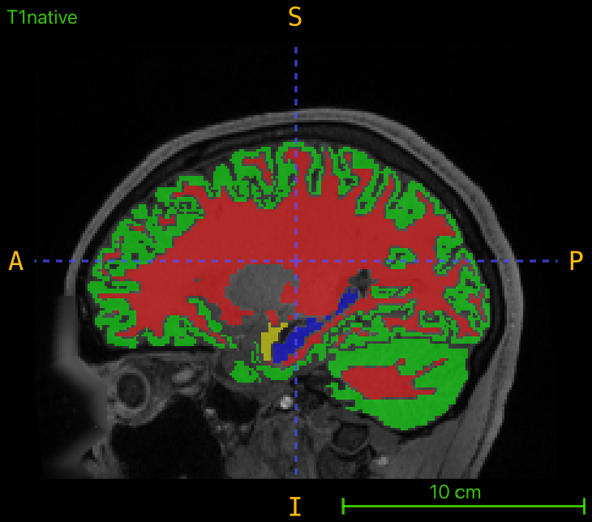
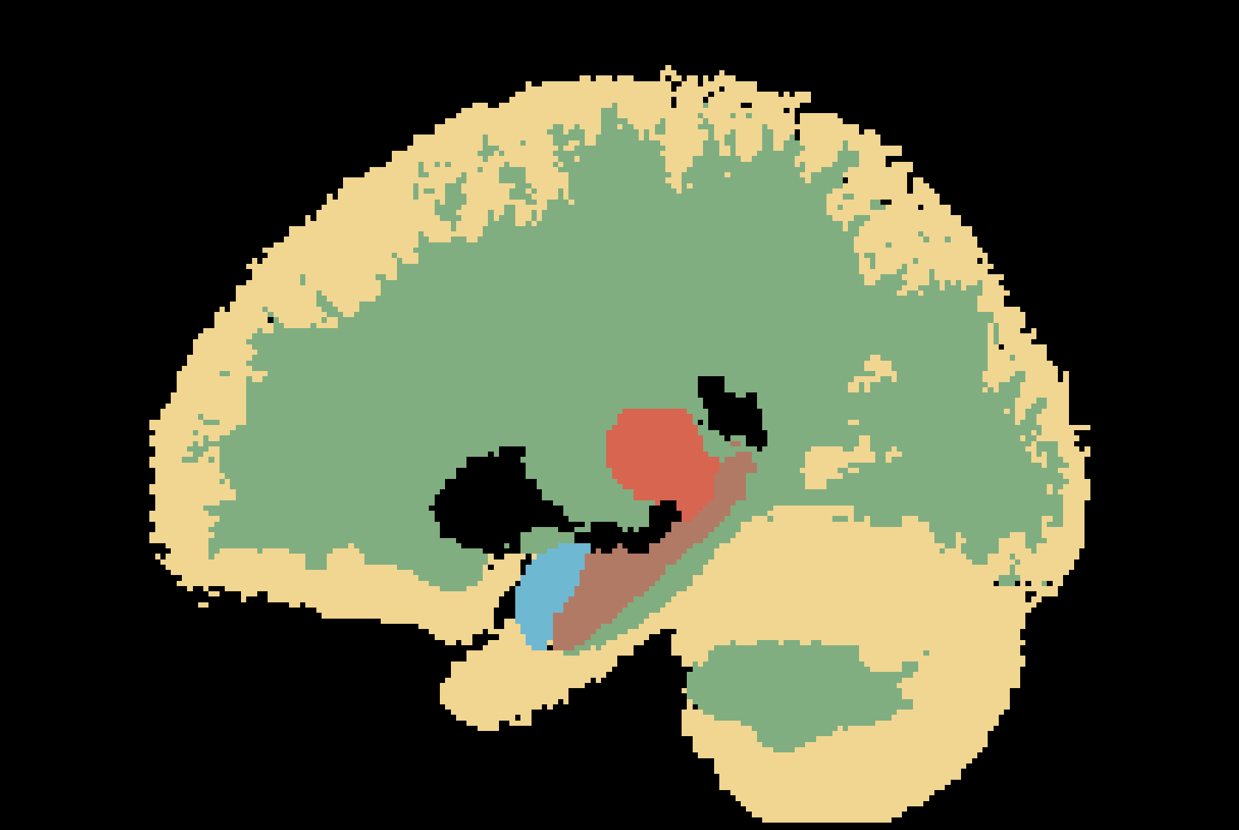
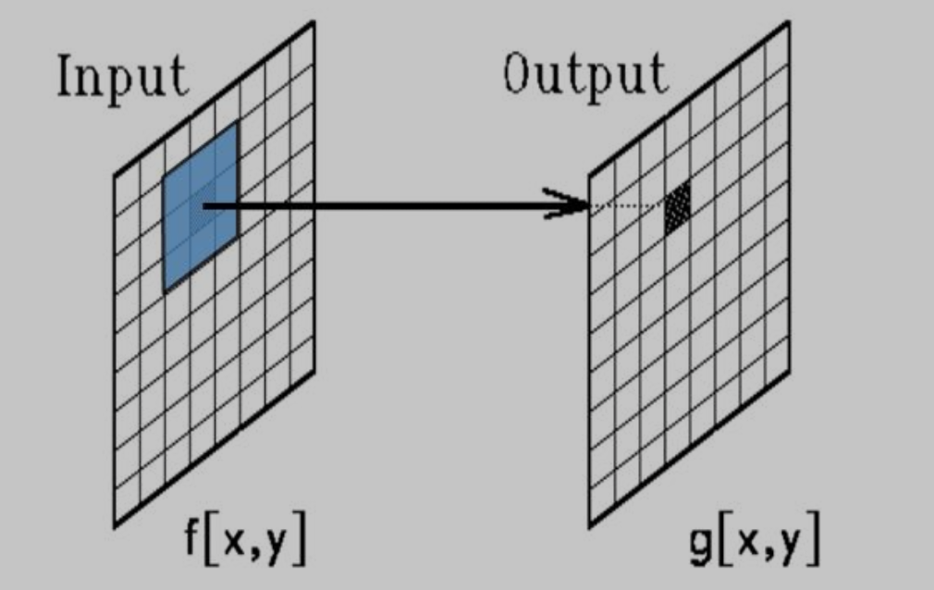
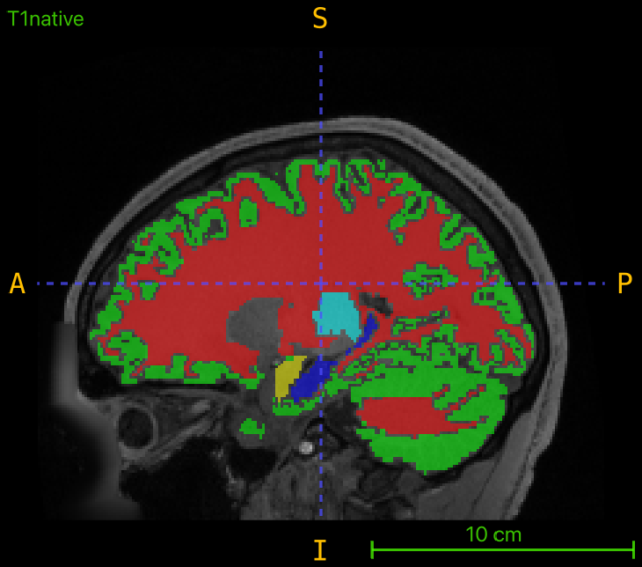

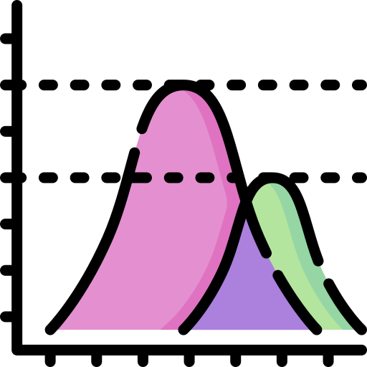
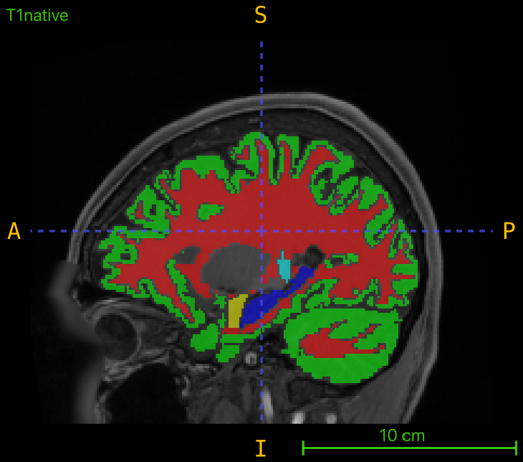



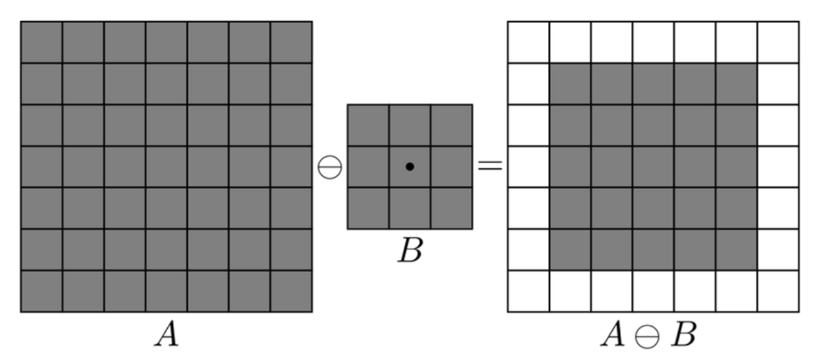
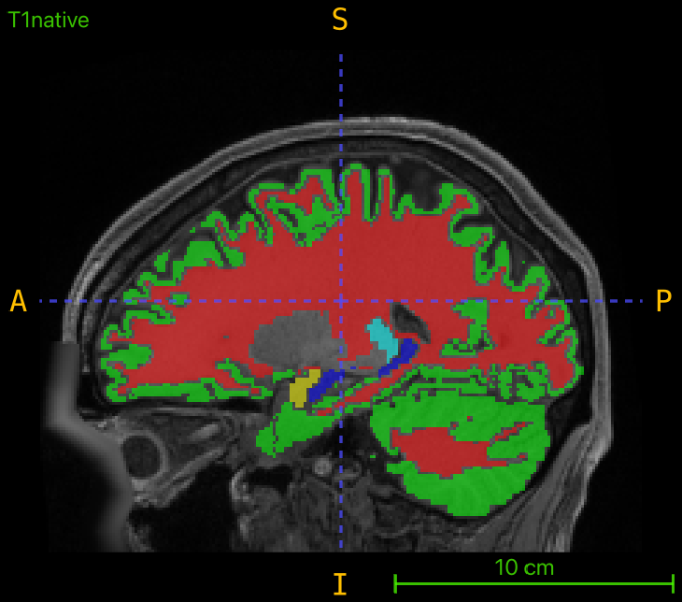
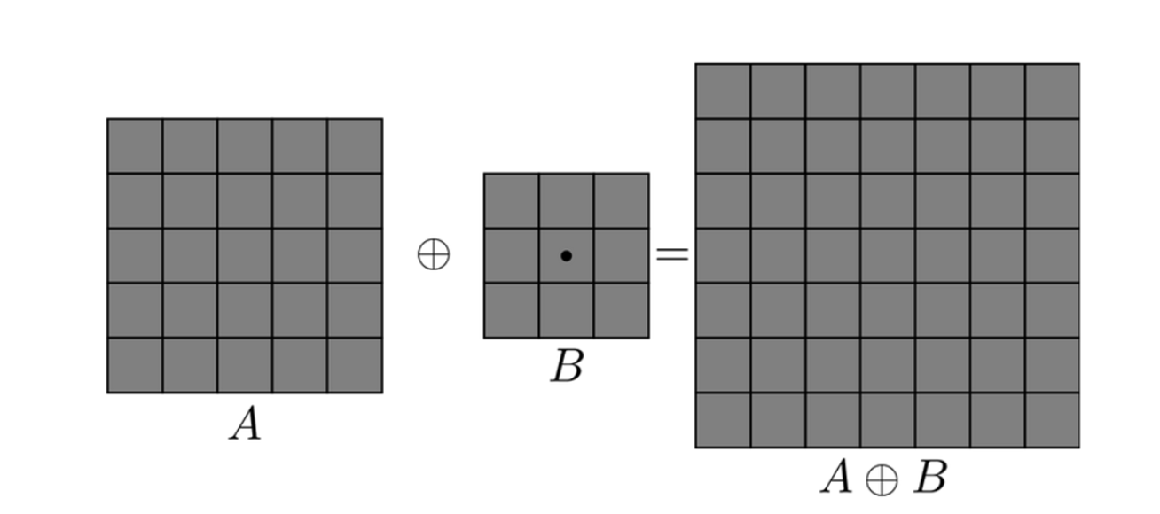
Construction of Atlas Labels
Train Images (20)
Registration to Atlas
Average all labels
Probability Map
Median & Morphological Filters
Notes:
How did we generate the labels?
Registered image to atlas, Averaging all labels of train data, probability map, take max probability, median filtering-morphological filters

Slide 4
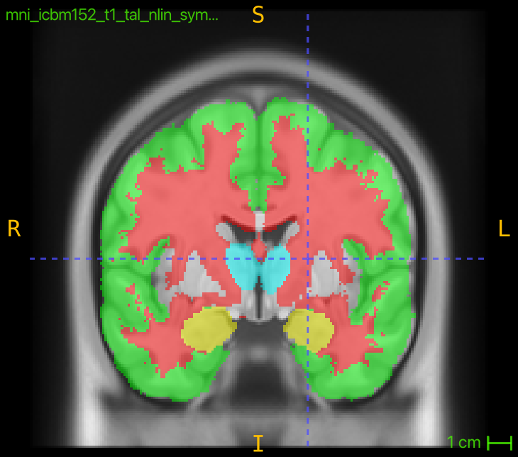
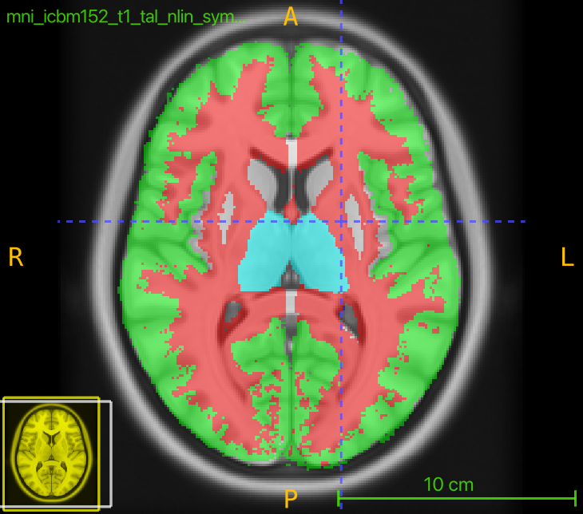
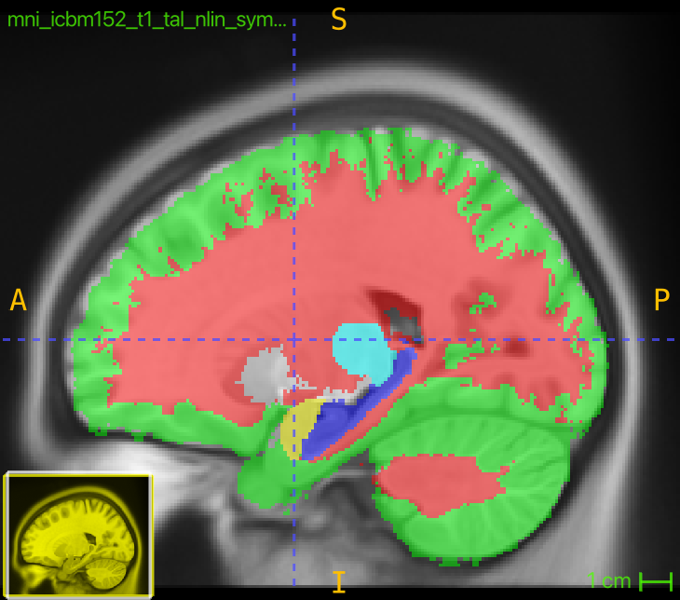
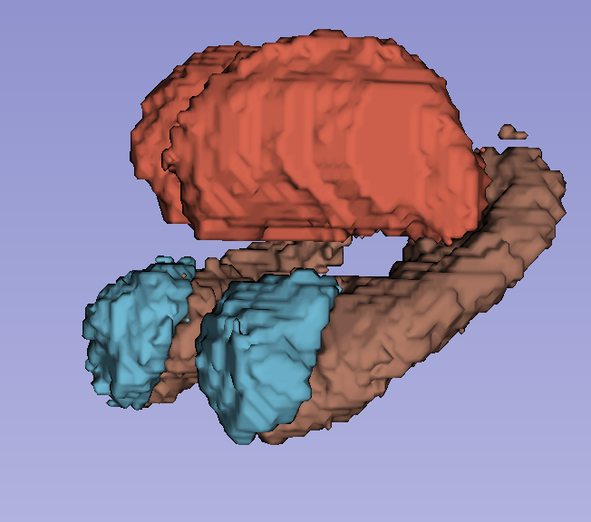
Resulting Atlas Labels
Before median filtering

Slide 5
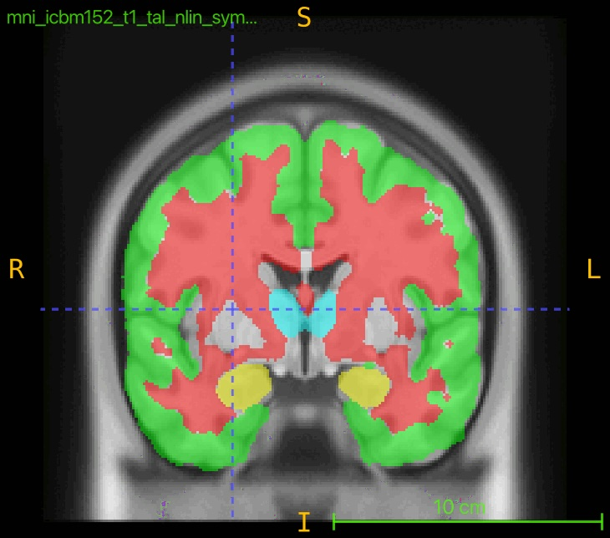
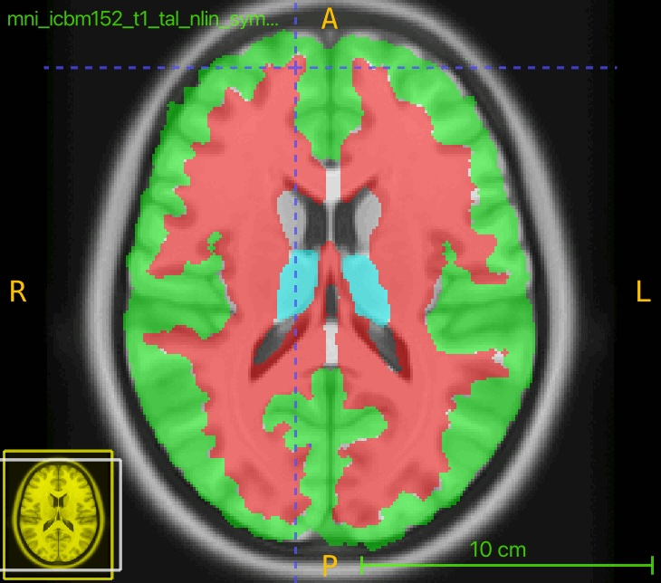
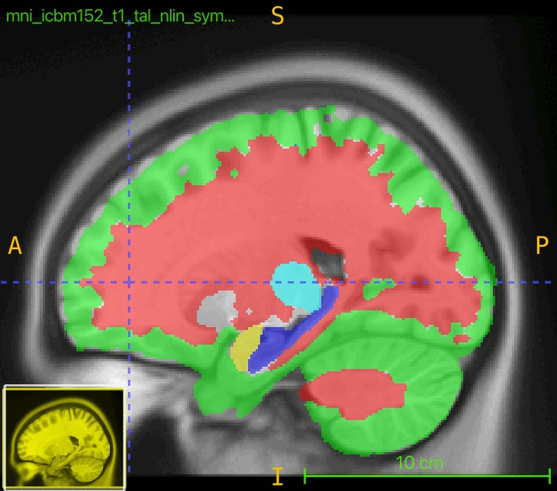
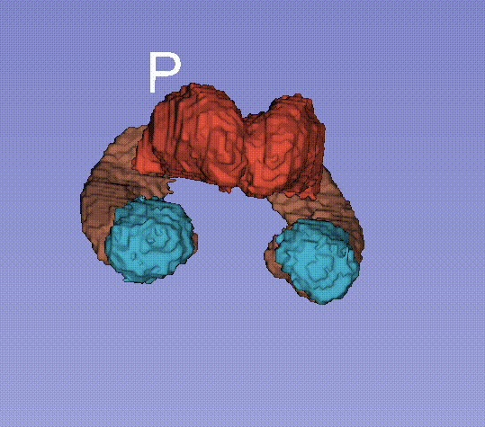
Resulting Atlas Labels

Slide 6
Random Forest Pipeline
Random Forest
Number of Trees: 700
Tree Depth: 45
DICE Scores
Time
Robustness
Affine registration
Pre-processing
Registration
Feature Extraction
Classification
Post-processing
Evaluation
Skull stripping
Z-Score Normalization
Salt & Pepper Noise
T1 & T2 Basic Descriptive Statistics (mean, SNR, variance..)
Skipped

Slide 7
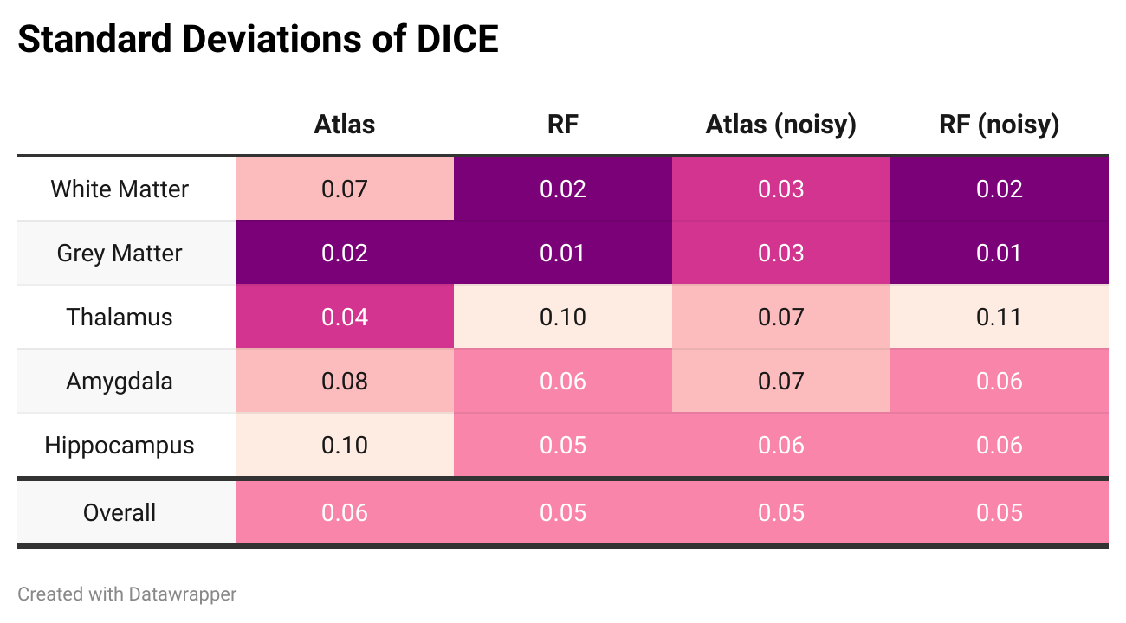
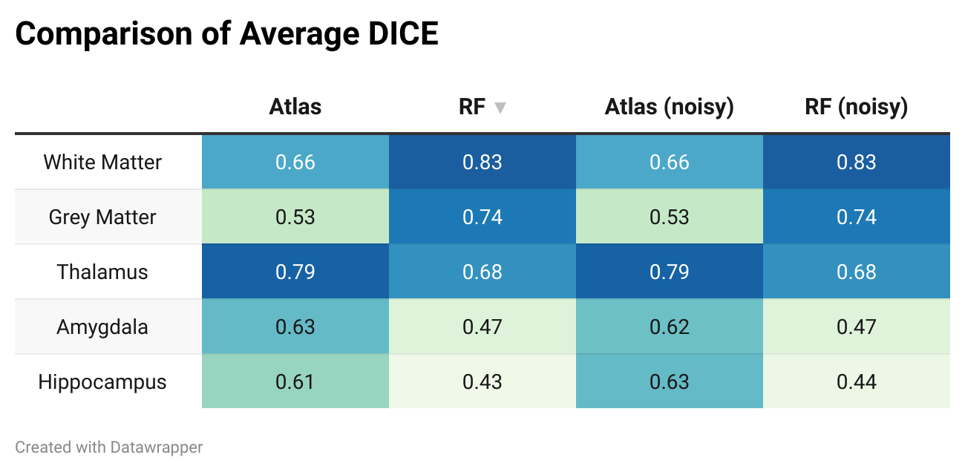
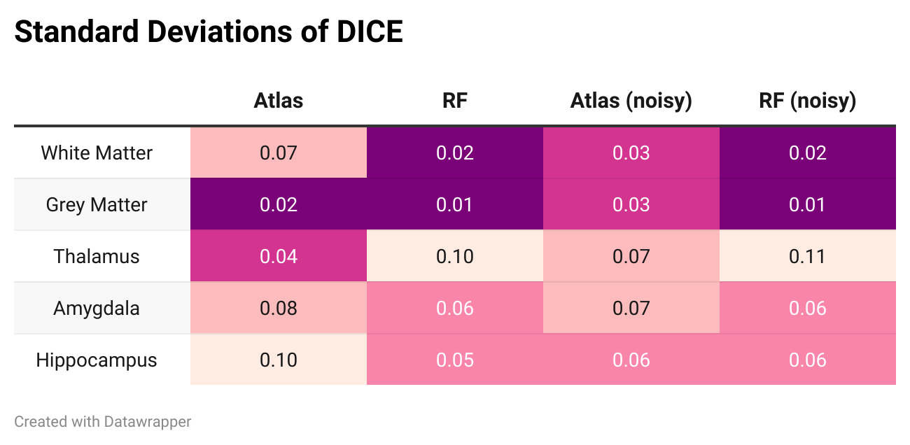
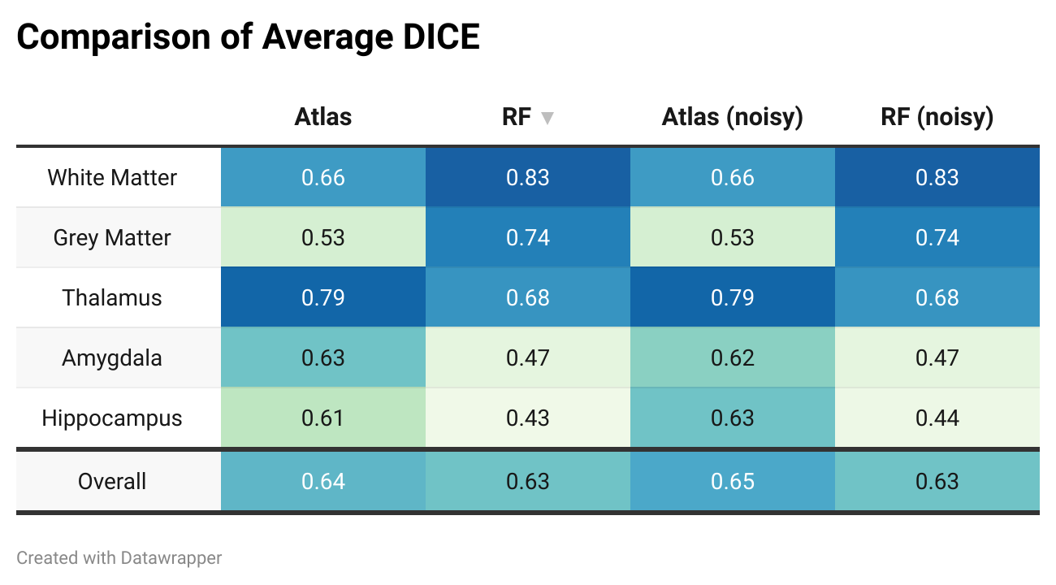
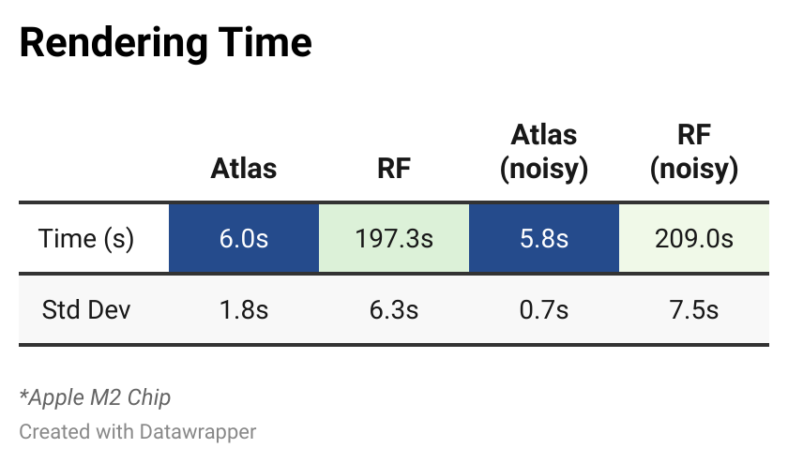
Results

Slide 8
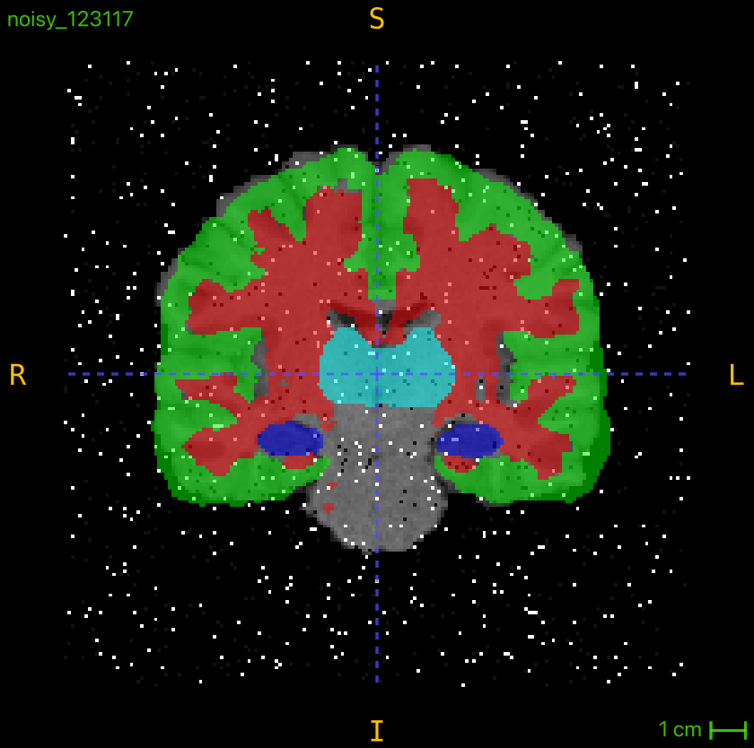
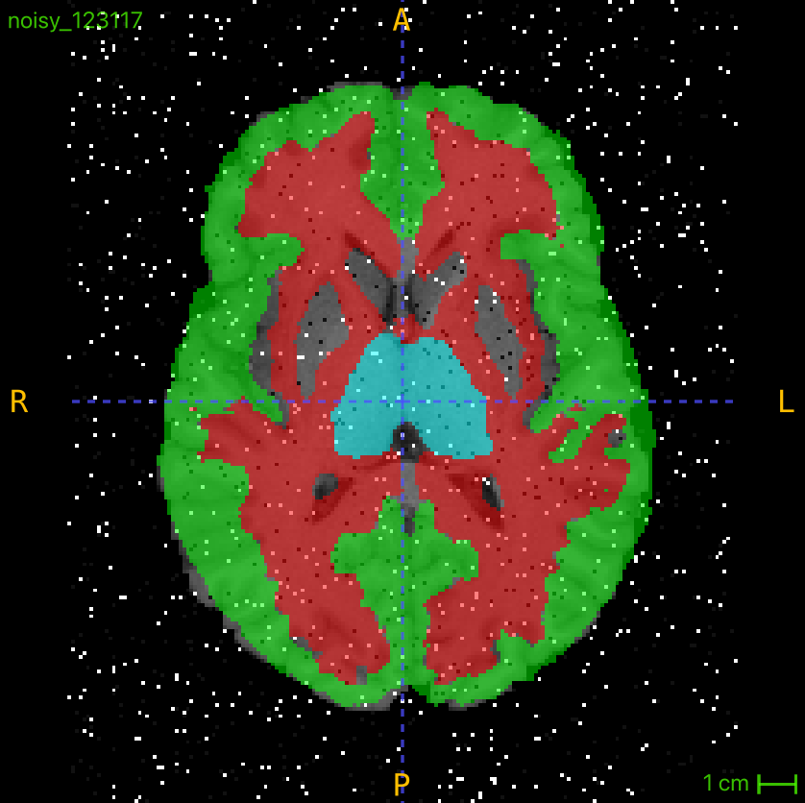
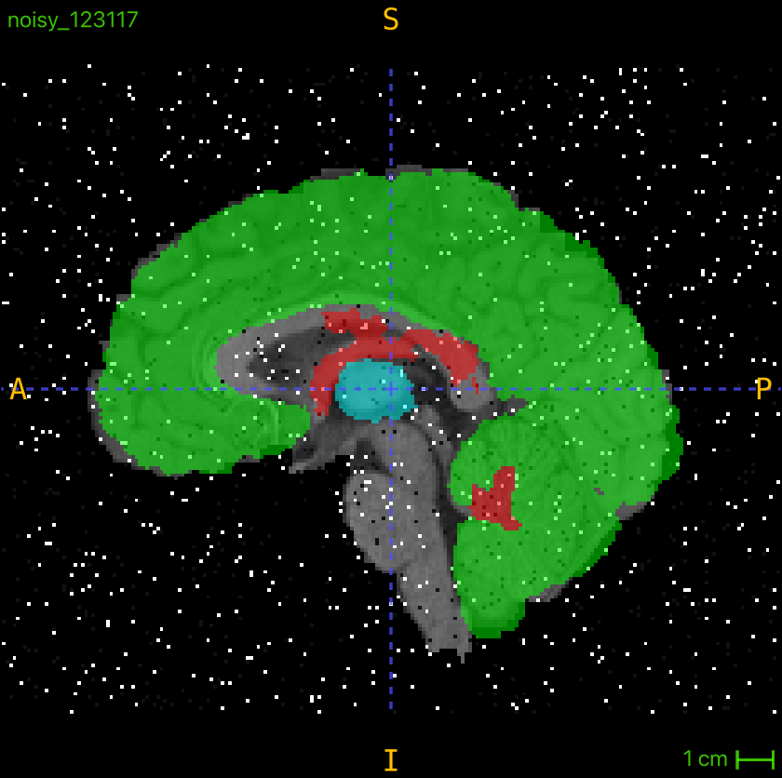
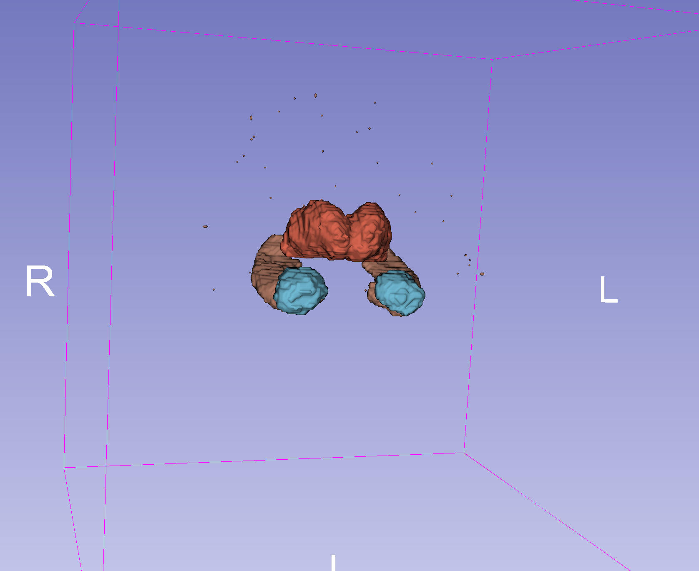
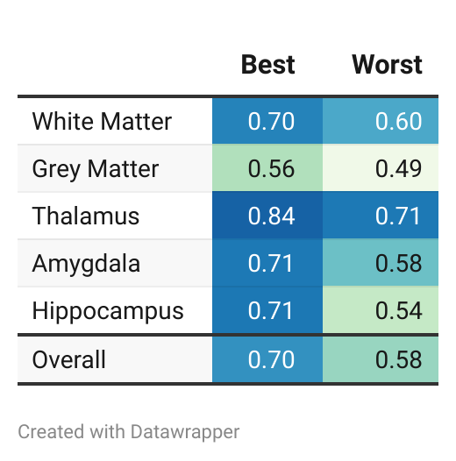
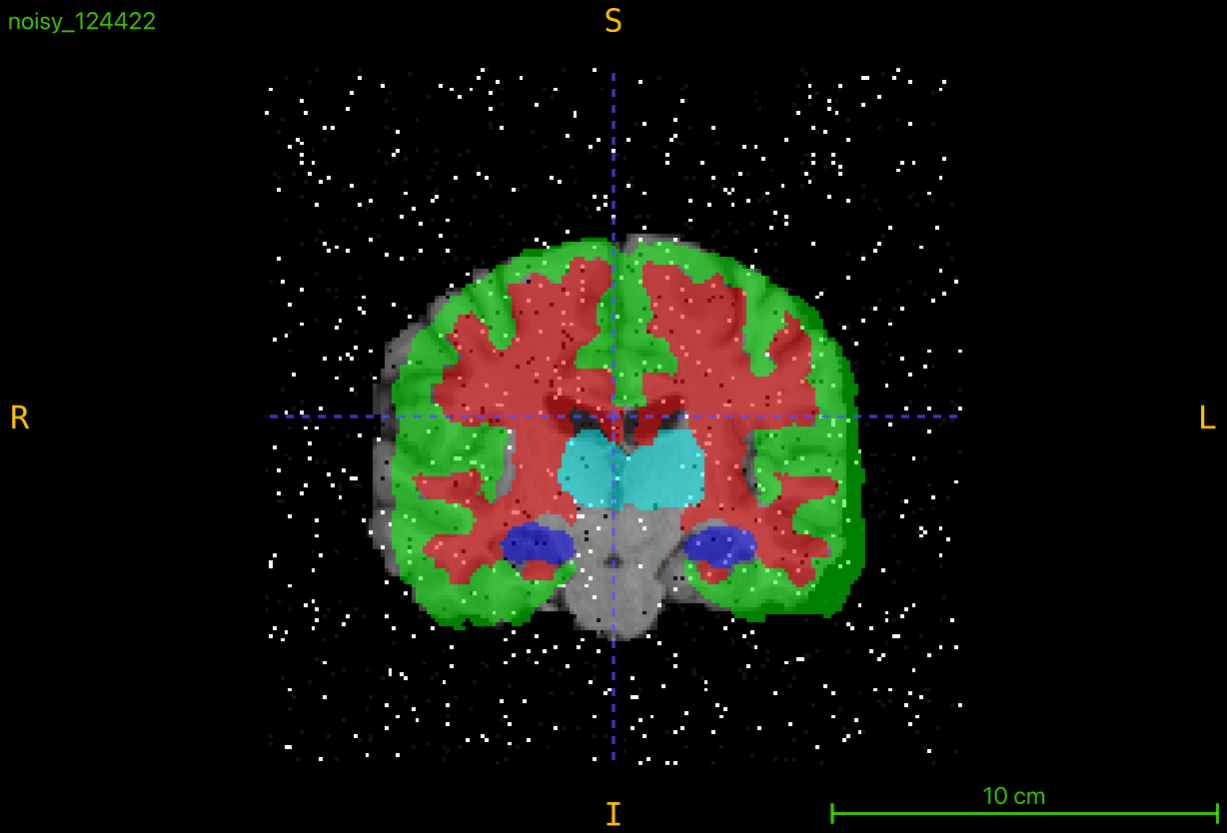
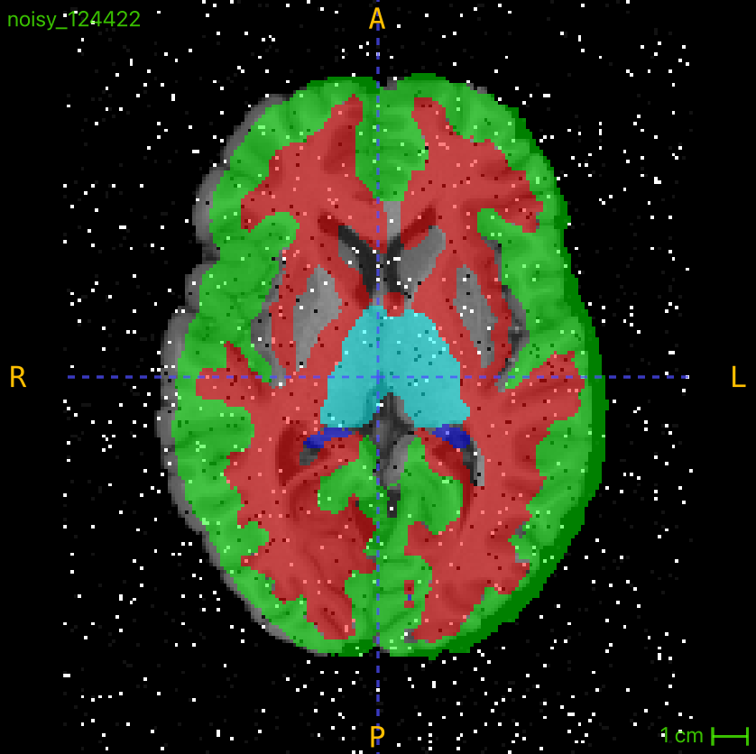
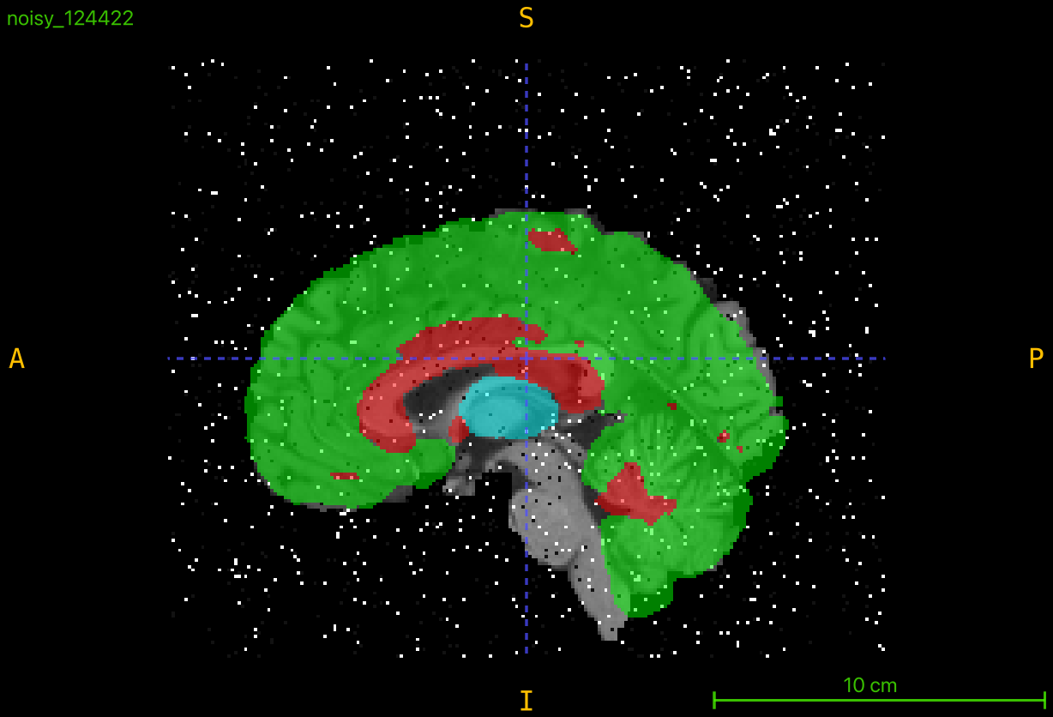
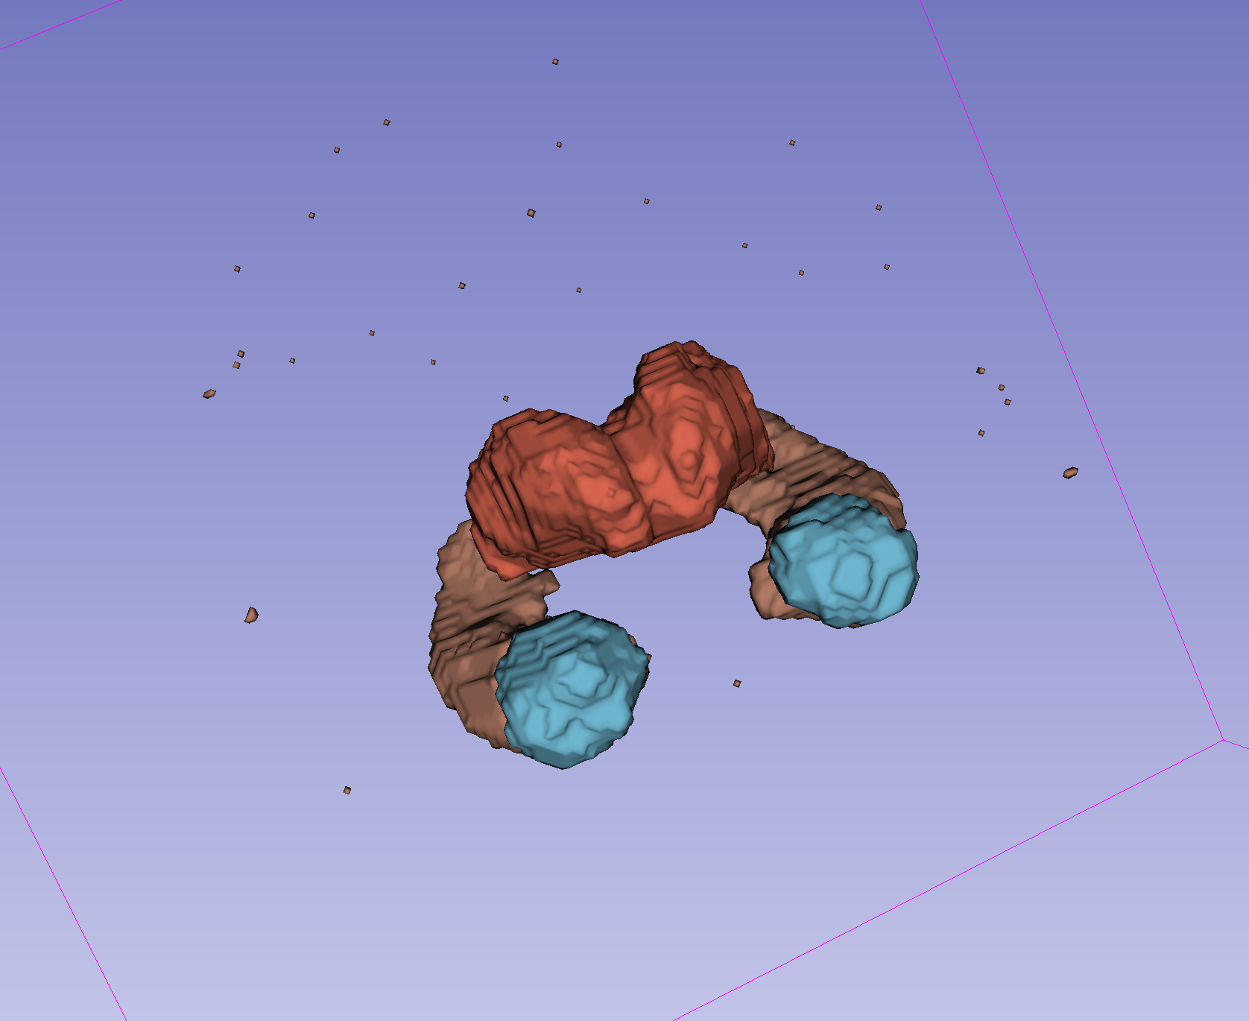
Atlas (Best & Worst)

Slide 9
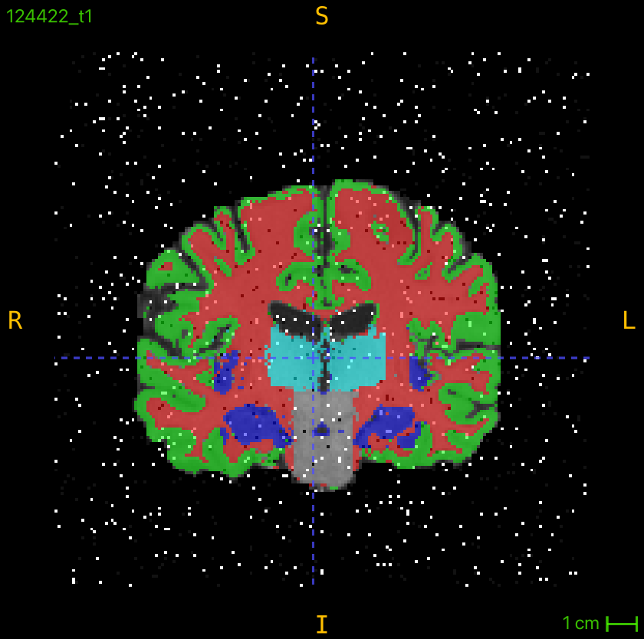
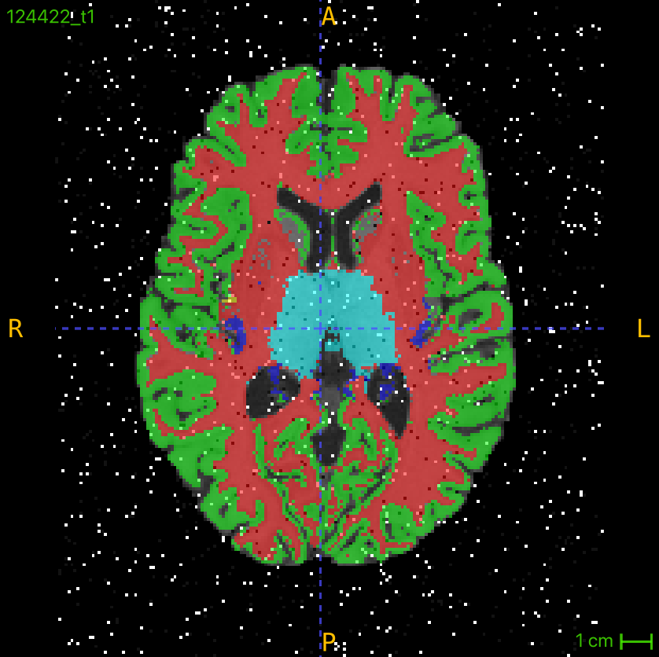
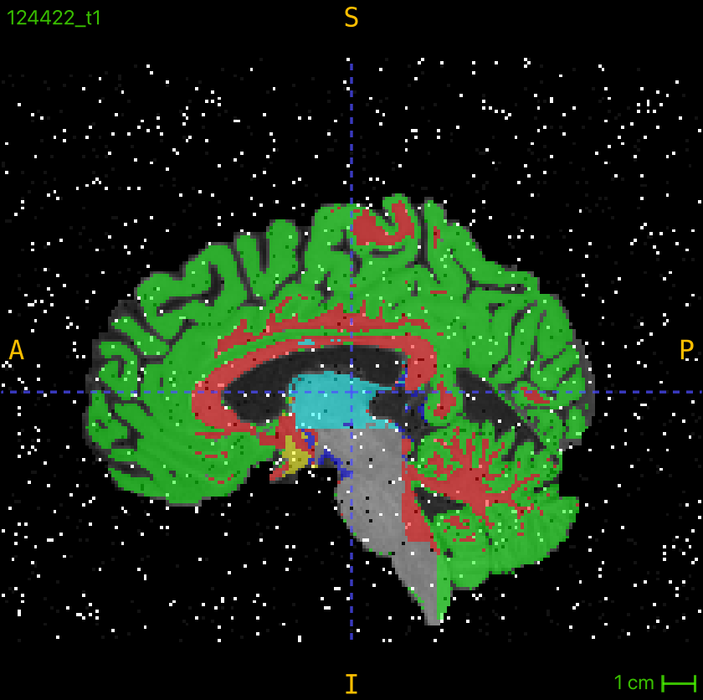
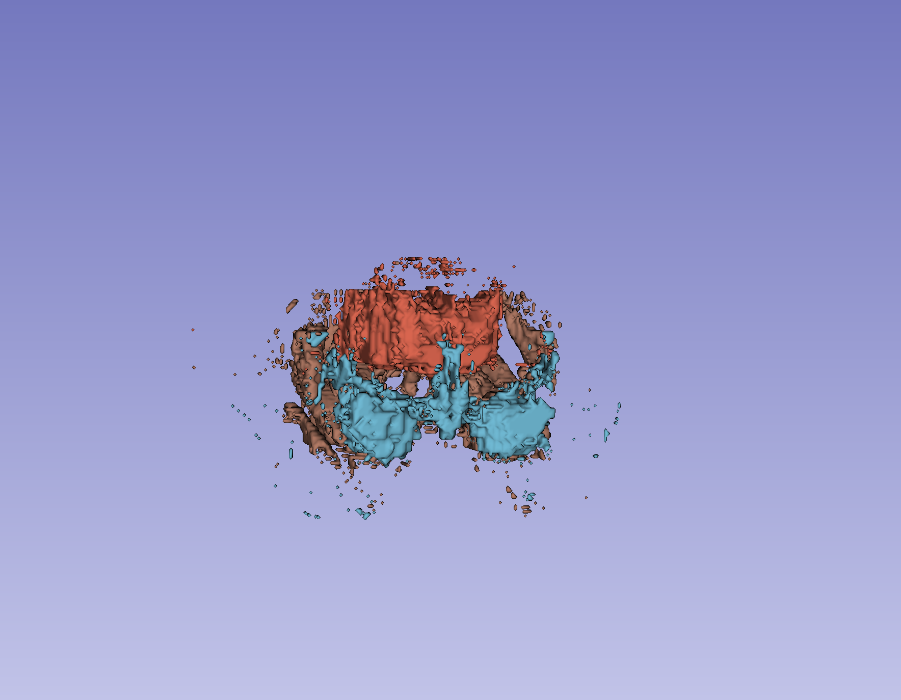
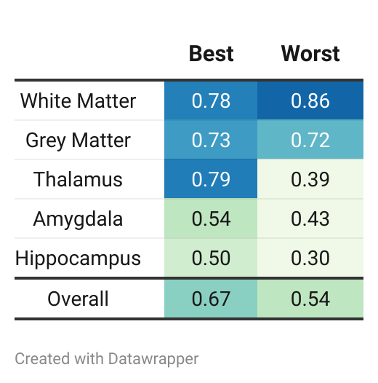
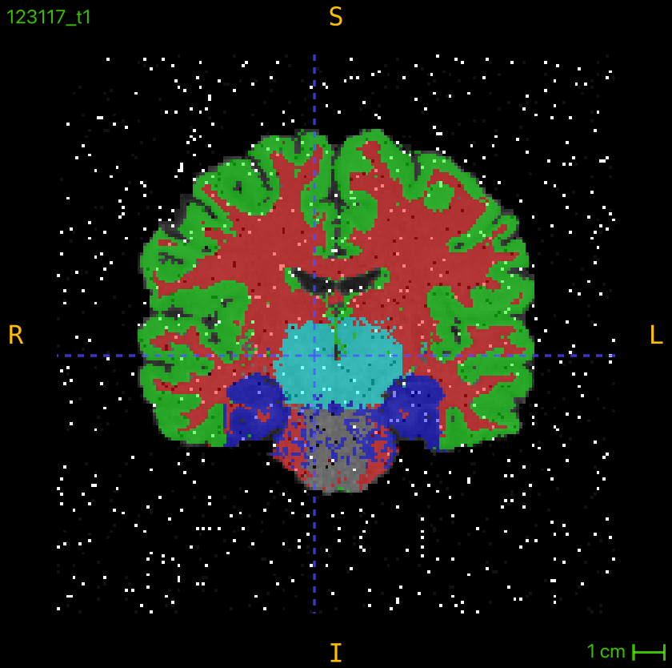
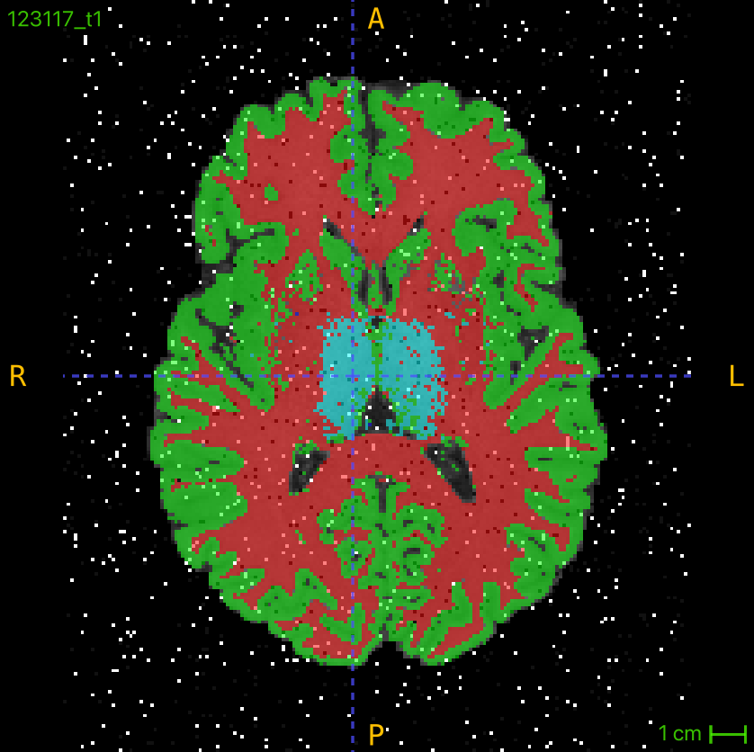
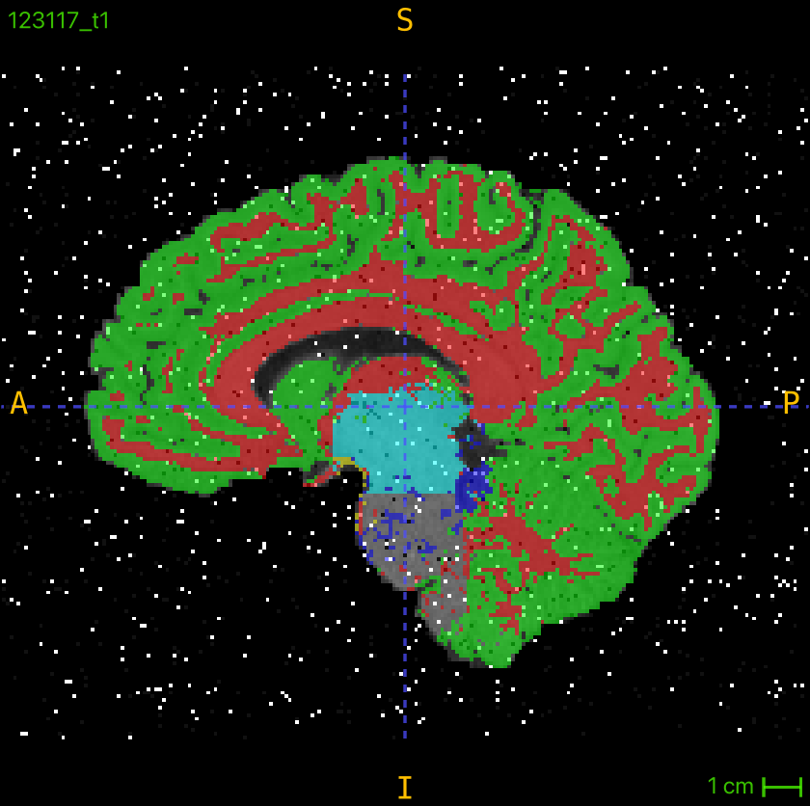
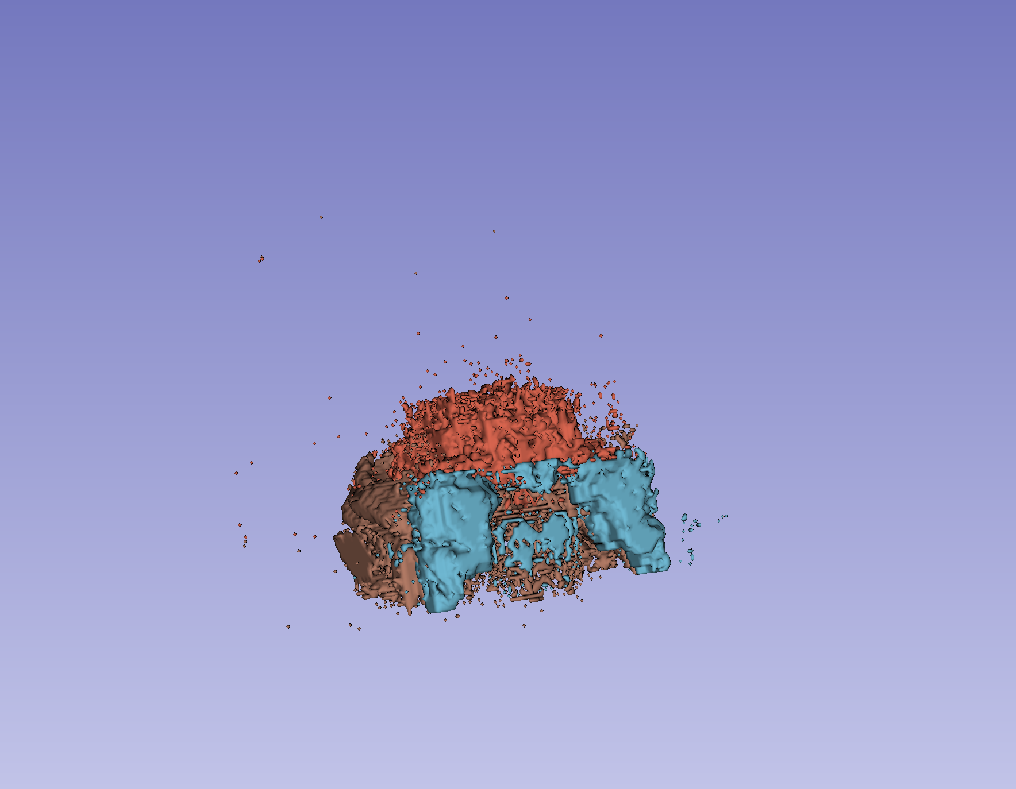
RF (Best & Worst)
9

Slide 10
Discussion
Random Forest Strengths
Segmenting large structures (white/grey matter)
Adapts well to new data
Atlas-Based Method Strengths
Small, consistent structures (e.g., thalamus)
Segmentation within seconds, ideal for clinical use
Challenges
Atlas-based struggles with spatial variation in tissues (grey/white matter) and depends on atlas quality
Random Forest takes several minutes to evaluate → requiring optimization for clinical use
Robustness against noise
Both methods handle noise well, with Random Forest showing unexpected strength against noisy data
Future Development
Combine Atlas for small and RF for large structures

Slide 11


Which do you choose?
Notes:
Before we finish, we just have one last very important question

Slide 12


Slide 13
References
[1] D. A. Dickie et al., “Whole Brain Magnetic Resonance Image Atlases: A Systematic Review of Existing Atlases and Caveats for Use in Population Imaging,” Front. Neuroinform., vol. 11, Jan. 2017, doi: 10.3389/fninf.2017.00001.
[2] “Scientists just drafted an incredibly detailed map of the human brain,” MIT Technology Review. Accessed: Nov. 30, 2024. [Online]. Available: https://www.technologyreview.com/2023/10/12/1081607/brain-atlas-cells-humans-primates

Slide 14
END

